Slide 1
Agile Software Development
Lecturer: Ngô Huy Biên
nhbien@fit.hcmus.edu.vn

Slide 2

Objectives
Present XP

Slide 3

Books And Reading
James Martin (1991). Rapid application development.
Craig Larman, Agile and Iterative Development: A Manager's Guide. 2003
Ken Schwaber, Agile Project Management with Scrum. 2004
Kent Beck, Cynthia Andres, Extreme Programming Explained: Embrace Change. 2004
Steve Mcconnell, Rapid Development - Taming Wild Software Schedules. 2005.
Kai Gilb, Evo - Evolutionary Project Management. 2007
Alistair Cockburn, Agile Software Development: The Cooperative Game, Second Edition. 2006.
Jennifer Stapleton, DSDM Business Focused Development. 2003.

Slide 4
Rapid Application Development [1]
RAD is an approach to building computer systems which combines
Computer-Assisted Software Engineering (CASE) tools and techniques,
user-driven prototyping, and
stringent project delivery time limits into a potent, tested, reliable formula for top-notch quality and productivity.
RAD takes advantage of automated tools and techniques to restructure the process of building information systems.
RAD replaces hand-design and coding processes, which are dependent upon the skills of isolated individuals, with automated design and coding, which is an inherently more stable process.

Slide 5
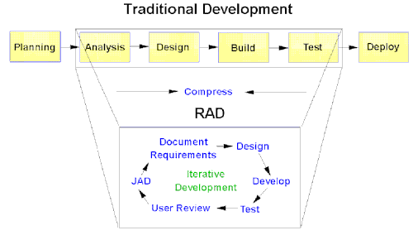
The RAD Approach
RAD compresses the step-by-step development of conventional methods into an iterative process.
The RAD approach thus includes developing and refining the data models, process models, and prototype in parallel using an iterative process.
User requirements are refined, a solution is designed, the solution is prototyped, the prototype is reviewed, user input is provided, and the process begins again.

Slide 6
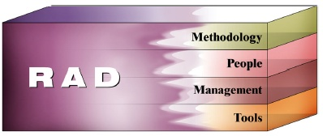
Essential Aspects of RAD
Rapid Application Development has four essential aspects:
methodology,
people,
management, and
tools.
If any one of these ingredients is inadequate, development will not be high speed.

Slide 7


Slide 8
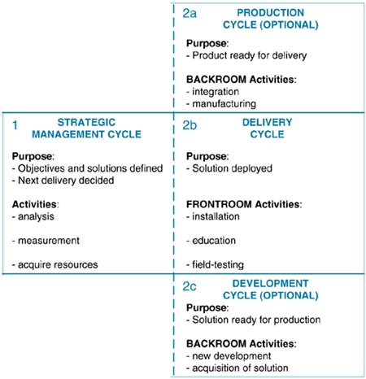
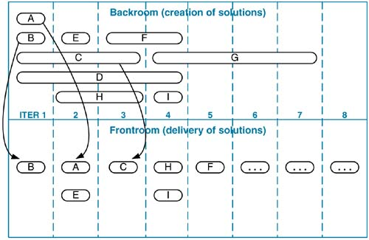
Evolutionary Project Management

Slide 9
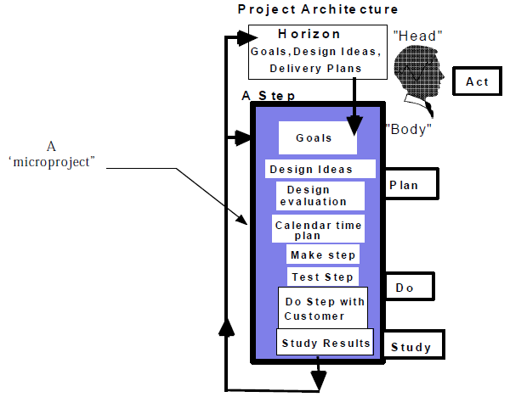
Evolutionary Management

Slide 10
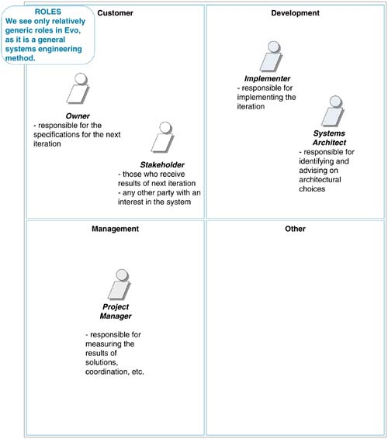
Evo Roles

Slide 11
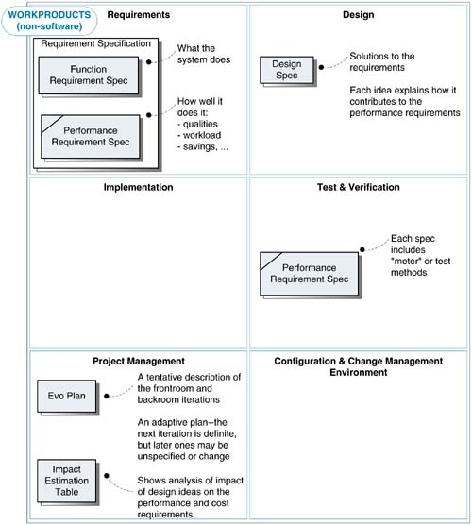
Evo Work Products

Slide 12
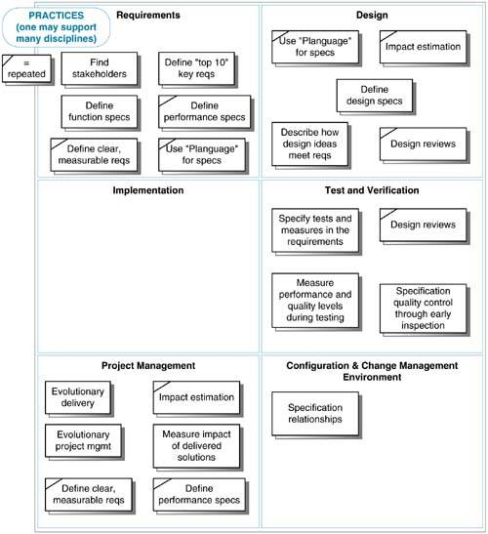
Evo Practices

Slide 13
Evo Values
Learn rapidly by realistic measurement.
Deliver real value to stakeholders early, frequently, at every step.
Be humble about complex systems: simplify and attack problems one small step at a time
Admire, applaud and reward a team based on the flow of measurable results: stakeholder value versus costs.
Delegate power to the ultimate user, by focusing on end results and not methods and well-intended bureaucracy.

Slide 14

Learnable Example
TAG: Learnable
GIST: The ease of learning to use the system.
SCALE: Time required for a Novice to complete a 1-item order using only the online help system for assistance.
METER: Measurements obtained on 100 Novices during user interface testing.
MUST: No more than 7 minutes 80% of the time
PLAN: No more than 5 minutes 80% of the time
WISH: No more than 3 minutes 100% of the time
PAST [our old system]: 11 minutes recent site statistics
Novice: DEFINED: A person with less than 6 months experience with Web applications and no prior exposure to our Website.
“The system must be easy to learn.”
“The system must be used successfully to place an order in under 10 minutes without
assistance by at least 80% of test subjects with no previous system experience.”

Slide 15
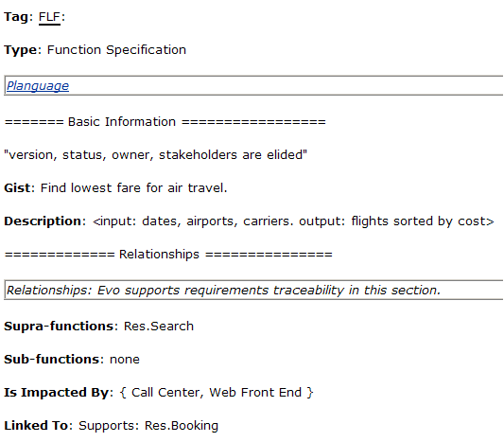
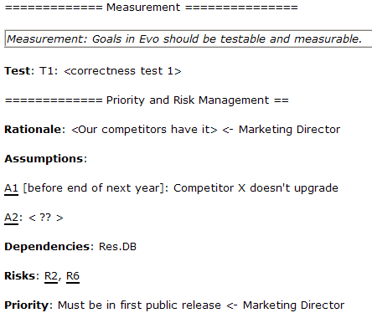
Function Requirement Specification Example
Fuzzy term
Comment
Qualifier
Sub-parameter
Parent.Child structure
Set
Origin of data
Tag defined somewhere

Slide 16
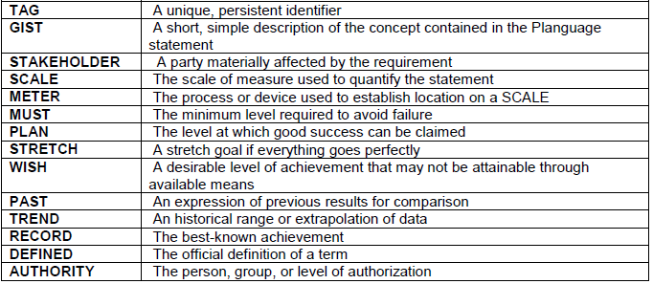


PLanguage
Planguage is Evo's compact specification language.
METER
QUALIFIERS

Slide 17
Impact Estimation
Impact Estimation (IE) tables allow you to analyze any technical or organizational idea in relation to requirements and costs.
Responsive Browsing
5s | -> | 3s
Baseline |  | Goal
Baseline | Ideas | Time | Impact
1 server (5s) | 2 servers | 4s | 50%
 | 3 servers | 3s | 100%
 | Shared hosting | 6s | -50%
Comparing alternative design ideas.

Slide 18
Quality-to-Cost Ratio
 | Candidate A: | Candidate B:
100% =Plan level
Reliability 99%-99.9% | 50% | 100%
Performance 11sec.-1sec. | 80% | 30%
Usability 30 min.-30sec. | -10% | 20%
Capital Cost 1 mill. | 20% | 5%
Engineering Hours 10,000 | 2% | 10%
Quality/Cost Ratio | 120/22=5.46 | 150/15=10.00
Estimating the state of the overall design architecture.

Slide 19
Uncertainty of Impact
 | Candidate A: | Candidate B:
100% =Plan level
Reliability 99%-99.9% | 50%±50% | 100%±20%
Performance 11sec.-1sec. | 80%±40% | 30%±50%
Usability 30 min.-30 sec. | -10%±20% | 20%±15%
Capital Cost 1 mill. | 20%±1% | 5%±2%
Engineering Hours 10,000 | 2%±1% | 10%±2.5%
Worst Case | (0+40-30)/(21+3) =0.42 | (80-20+5)/(7+12.5) =3.33
Best Case | (100+120+10)/(19+1) = 11.5 | 120+80+35)/(3+7.5)= 22.38
Analyzing risk.

Slide 20
Credibility Rating
Credibility Rating | Meaning
0.0 | Wild guess, no credibility.
0.1 | We know it has been done somewhere.
0.2 | We have one measurement somewhere.
0.3 | There are several measurements in the estimated range.
0.4 | The measurements are relevant to our case.
0.5 | The method of measurement is considered reliable.
0.6 | We have used the method in-house.
0.7 | We have reliable measurements in-house.
0.8 | Reliable in-house measurements correlate to independent external measurements.
0.9 | We have used the idea on this project and measured it.
1.0 | Perfect credibility, we have rock solid, contract-guaranteed, long-term, credible experience with this idea on this project, and the results are unlikely to disappear.
1 server | 2 servers | Impact | Credibility | Impact
5s | 4s | 50% | 0.2 | 10%

Slide 21
Credibility of Estimation
 | Candidate A: | Candidate B:
Credibility | 0.9 | 0.1
Reliability 99%-99.9% | 50%±50% | 100%±20%
Performance 11sec.-1sec. | 80%±40% | 30%±50%
Usability 30 min.-30 sec. | -10%±20% | 20%±15%
Capital Cost 1 mill. | 20%±1% | 5%±2%
Engineering Hours 10,000 | 2%±1% | 10%±2.5%
Worst Case | (0+40-30)/(21+3) =0.42 | (80-20+5)/(7+12.5) =3.33
‘Worst Worst’ case considering estimate credibility factor | 0.9x0.42=0.378 | 3.33x0.1=0.333

Slide 22
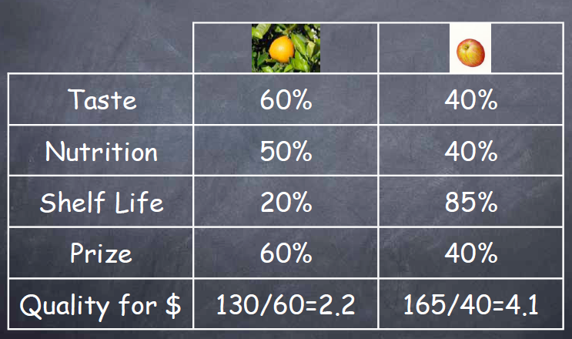
How do we compare apples and oranges?

Slide 23
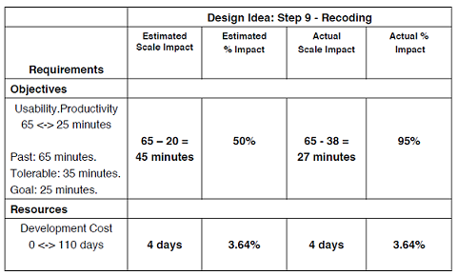
Evo Plan & Results
Planning and controlling evolutionary project delivery steps.
Target Requirements | Iteration 1 (plan, actual) | Iteration 2 | Cumulative to date
Responsive Browsing | 5%, 2%^{[a]} | 10%, __ | 2%
System Reliability | 10%, 5% | 20%, __ | 5%
Capital Costs | 0%, 0% | 5%, __ | 0%
Development Costs | 2%, 2% | 2%, __ | 2% [a] the percentage of the final target

Slide 24
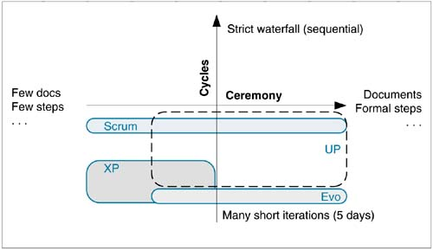
Classification

Slide 25


Slide 26
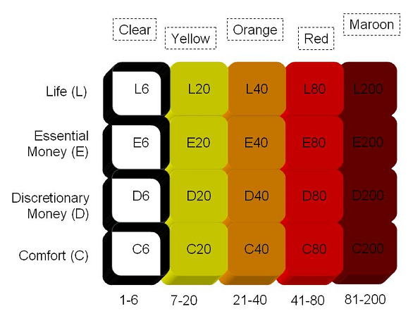
Crystal
Crystal Clear:
Roles:
Sponsor
Senior Designer
Programmer
Release: 60 – 90 days
Deliverables: Release plan, Design sketches, Working software…
Crystal Orange:
Roles:
Sponsor
Business Analyst
Architect
Senior Designer
Programmer
Project Manager
Release: 90 – 120 days
Deliverables: SRS, Release Plan, Schedule,
Design Specs…
Project classes further from the bottom left corner of the table require a more formal process than project classes closer to the bottom left corner.

Slide 27
Policy Standards
Software is delivered incrementally and regularly, every two to three months
Progress is tracked by milestones consisting of software deliveries or major decisions, as opposed to written documents
There is some amount of automated regression testing of application function
There is direct user involvement
There are two user viewings per Downstream activities start as soon as upstream is "stable enough to review"
Product- and methodology-tuning workshops are held at the start and middle of each increment

Slide 28
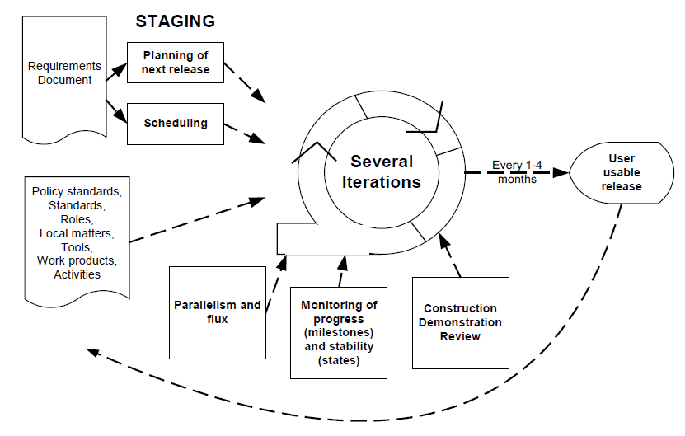
One Crystal Orange Increment

Slide 29
Crystal Values
People- and communication-centric
Highly tolerant

Slide 31
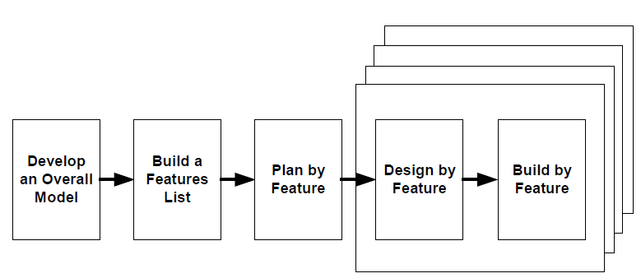
Feature Driven Development

Slide 32
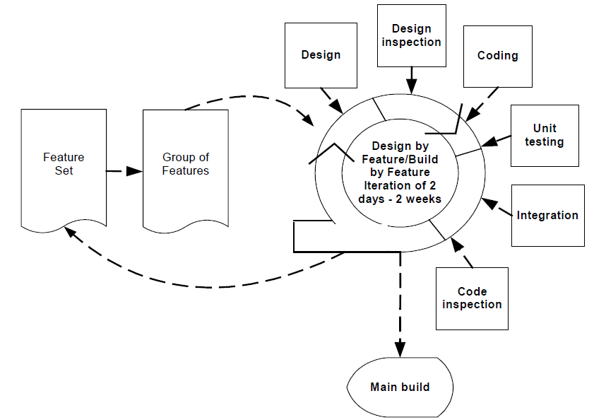
Design/Build by Feature

Slide 33
FDD Roles
Domain Expert
Chief Architect
Development Manager
Chief Programmer
Class Owner
Project Manager

Slide 34
FDD Practices
Domain Object Modeling
Developing by feature
Individual Class (Code) Ownership
Feature Teams
Inspection
Regular Build
Configuration Management
Progress reporting

Slide 35
FDD Values
Supports multiple teams working in parallel
All aspects of a project tracked by feature, reduce the risk of fixed-price
Design by feature and build by feature aspects are easy to understand and adopt
Scales to large teams or projects well

Slide 37
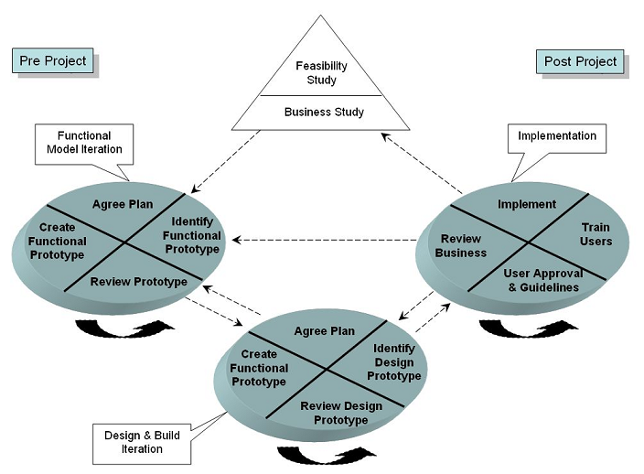
Dynamic Systems Development Method

Slide 38
DSDM Principles
Active user involvement is imperative
The Team Must Be Empowered to Make Decisions
Frequent delivery is key
The primary criterion for acceptance is the delivery of functionality that meets the current business needs
Iterative and incremental delivery is essential
All changes during the project lifecycle are reversible
Requirements are base-lined at a high level
Integrated testing during the entire project lifecycle is expected
Collaboration and cooperation between all stakeholders is essential

Slide 39
DSDM Work Products
Feasibility Report, Outline Plan, Fast Prototype
ER Diagram, Business Object Model
Prioritized Functions, Review Documents
Non-functional Requirements, Risk List For Further Development, Configuration Plan
User Manual, Project Review
Architecture Design, Prototyping Plan

Slide 40
DSDM Roles
(Ambassador) User
Executive Sponsor
Project Manager
Visionary
Advisor
Team Manager
Developer
Scribe
Technical Coordinator

Slide 41
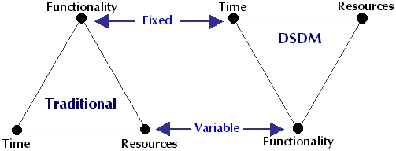
MoSCoW Rules
MUST have this requirement.
SHOULD have this requirement if at all possible.
COULD have this requirement if it can be delivered without major impact.
WOULD like to have these requirements if there is enough time remaining.

Slide 42
DSDM Practices
MoSCoW Prioritization
TimeBoxing
Facilitated Workshops
Prototyping

Slide 43
DSDM Values
System is delivered on time and on budget
Early indicators of whether project will work or not, rather than a nasty surprise halfway through the development
Basic functionality is delivered quickly, with more functionality being delivered at regular intervals
Business Driven
Suitable for IT and non-IT projects

Slide 45
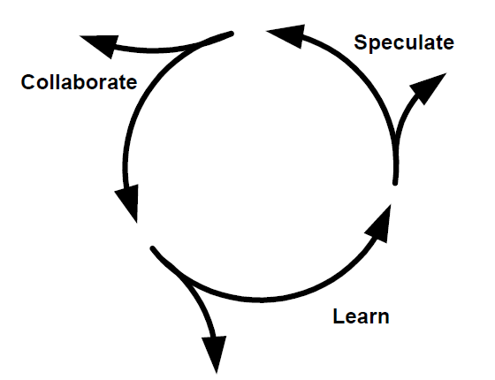
Adaptive Software Development
Postulates a general idea of where we are going, and put mechanisms in place to adapt.
Portrays a balance between managing the doing (the main thrust of traditional management) and creating and maintaining the collaborative environment needed for emergence.
Examines assumptions and use the results of each development cycle to learn the direction of the next.

Slide 46
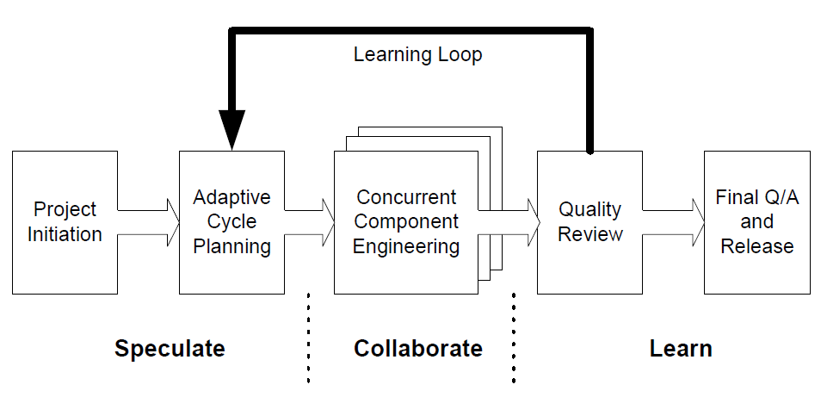
ASD Phrases
The three stages overlap and last in 4 – 8 weeks

Slide 47
ASD Principles
Mission Driven
Component-Based
Iterative
Time-Boxed
Change-Tolerant
Risk Driven

Slide 48
ASD Roles
Facilitator
Project Manager
Executive Sponsor
Customer
Team Manager
Developer
Scribe

Slide 49
ASD Practices
Build good enough software
Focus less on process but on product
Simple
Focus on the highest-value features early in the projects
Consider alternatives and adaptive actions

Slide 50
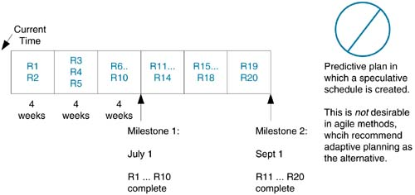
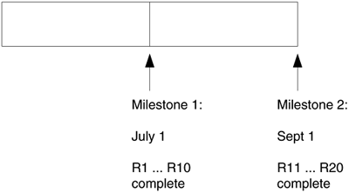
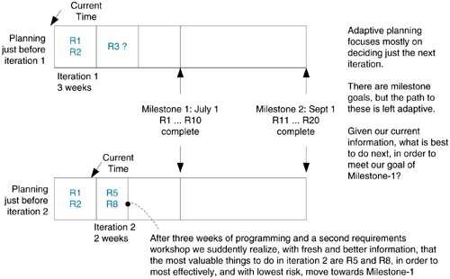
Adaptive Planning

Slide 51
ASD Values
Focuses on complex, large system
Be flexible and easy to adapt
Support visibility into the process

Slide 53
Adoption
Condition | XP | Scrum | Evo | FDD | UP | Crystal | DSDM | ASD
Small Team | √ | √ | √ | X | X | - | √ | X
Highly Volatile Requirements | √ | √ | √ | √ | - | - | X | √
Distributed Teams | X | √ | - | √ | √ | X | X | X
High Ceremony Culture | X | X | √ | - | √ | - | √ | √
High Criticality Systems | X | - | - | - | - | √ | X | √
Multiple Customers / Stakeholders | X | √ | √ | - | - | - | X | -

Slide 54
High-Level Summaries
Methodology | Summarizing Phrase
Scrum | Prioritized Business Value
XP | Simplicity, Technique
UP | Manage Risk
Evo | Realistic Measurement
Crystal | Size and Criticality
FDD | Business Model
DSDM | Current Business Value
ASD | Adaptation

Slide 55

Thank you for your time

